Slide 1
MA 207 Reviewing 1 and 2 proportion problems
Day 22

Slide 2
A recipe for confidence intervals:
If we gather data from a study, we can create a one number summary of our data, called a point estimate. This could be the sample proportion $\hat{p}$, the sample average $\overline{x}$, or the difference of proportions ${\hat{p}}_{1}−{\hat{p}}_{2}$, or averages ${\overline{x}}_{1}−{\overline{x}}_{2}$, ,.
When a point estimate is used to make claims about a wider population, we create a confidence interval around that point estimate.
$$point estimate ±Margin of Error$$
$$point estimate ±\left(how many SE\right)\left(size of SE\right)$$
$$point estimate±(z_{critical})(SE)$$
When we want a 95% confidence interval, the $z_{critical}$ will typically be 1.96.
The standard error (SE) is the standard deviation for the sampling distribution. The formula for this depends on which type of data we have. (See flow chart)

Slide 3
A recipe for hypothesis testing
Step 1: State the hypotheses
Step 2: Sampling Distribution
Based on the null hypothesis and the sample size, calculate the SE for your sampling distribution and note the center of your sampling distribution.
Step 3: Test statistic / p-value
Looking at your sample data, find your test statistic (z-score) and p-value for your point estimate.
If you are doing a 2-tailed test ($H_{A}$ has $≠$ in it), then double the results from your norm.dist() calculation.
Step 4: Conclusion:
With a significant level of $α=0.05$, we can (reject/not reject) the null hypothesis. In this situation, that means…

Slide 4
Teacher note
Build the flow chart on the board, instead of stepping through the following slides on Powerpoint. Ask all students to create their own flowchart for their notes, with all relevant equations.

Slide 5
What kind of data do I have?
Means
Proportions
1 proportion
2 proportions

Slide 6
What kind of data do I have?
Means
Proportions
1 proportion
2 proportions
Confidence interval
Hypothesis test
Confidence interval
Hypothesis test

Slide 7
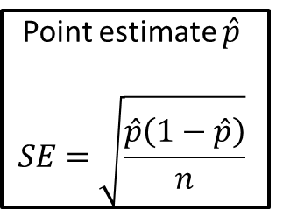
What kind of data do I have?
Means
Proportions
1 proportion
2 proportions
Confidence interval
Hypothesis test
Confidence interval
Hypothesis test
Point estimate $\hat{p}$
$$SE=\sqrt{\frac{\hat{p}\left(1−\hat{p}\right)}{n}}$$

Slide 8
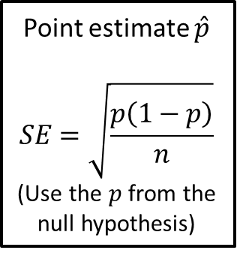
What kind of data do I have?
Means
Proportions
1 proportion
2 proportions
Confidence interval
Hypothesis test
Confidence interval
Hypothesis test
Point estimate $\hat{p}$
$$SE=\sqrt{\frac{\hat{p}\left(1−\hat{p}\right)}{n}}$$
Point estimate $\hat{p}$
$$SE=\sqrt{\frac{p\left(1−p\right)}{n}}$$
(Use the $p$ from the null hypothesis)

Slide 9
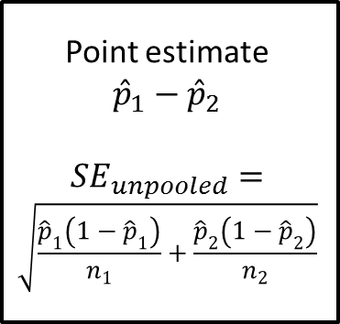
What kind of data do I have?
Means
Proportions
1 proportion
2 proportions
Confidence interval
Hypothesis test
Confidence interval
Hypothesis test
Point estimate $\hat{p}$
$$SE=\sqrt{\frac{\hat{p}\left(1−\hat{p}\right)}{n}}$$
Point estimate $\hat{p}$
$$SE=\sqrt{\frac{p\left(1−p\right)}{n}}$$
(Use the $p$ from the null hypothesis)
Point estimate ${\hat{p}}_{1}−{\hat{p}}_{2}$
$$SE_{unpooled}=$$
$$\sqrt{\frac{{\hat{p}}_{1}\left(1−{\hat{p}}_{1}\right)}{n_{1}}+\frac{{\hat{p}}_{2}\left(1−{\hat{p}}_{2}\right)}{n_{2}}}$$

Slide 10
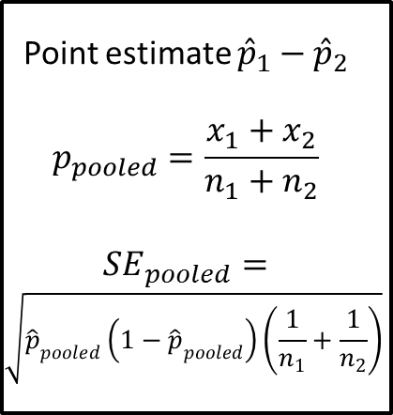
What kind of data do I have?
Means
Proportions
1 proportion
2 proportions
Confidence interval
Hypothesis test
Confidence interval
Hypothesis test
Point estimate $\hat{p}$
$$SE=\sqrt{\frac{\hat{p}\left(1−\hat{p}\right)}{n}}$$
Point estimate $\hat{p}$
$$SE=\sqrt{\frac{p\left(1−p\right)}{n}}$$
(Use the $p$ from the null hypothesis)
Point estimate ${\hat{p}}_{1}−{\hat{p}}_{2}$
$$SE_{unpooled}=$$
$$\sqrt{\frac{{\hat{p}}_{1}\left(1−{\hat{p}}_{1}\right)}{n_{1}}+\frac{{\hat{p}}_{2}\left(1−{\hat{p}}_{2}\right)}{n_{2}}}$$
Point estimate ${\hat{p}}_{1}−{\hat{p}}_{2}$
$$p_{pooled}=\frac{x_{1}+x_{2}}{n_{1}+n_{2}}$$
$$SE_{pooled}=$$
$$\sqrt{{\hat{p}}_{pooled}\left(1−{\hat{p}}_{pooled}\right)\left(\frac{1}{n_{1}}+\frac{1}{n_{2}}\right)}$$

Slide 11
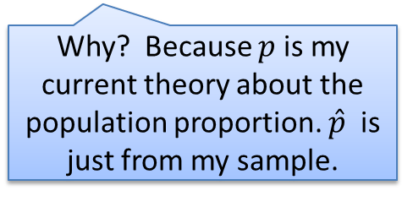
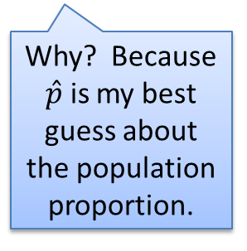
What kind of data do I have?
Means
Proportions
1 proportion
2 proportions
Confidence interval
Hypothesis test
Confidence interval
Hypothesis test
Point estimate $\hat{p}$
$$SE=\sqrt{\frac{\hat{p}\left(1−\hat{p}\right)}{n}}$$
Point estimate $\hat{p}$
$$SE=\sqrt{\frac{p\left(1−p\right)}{n}}$$
(Use the $p$ from the null hypothesis)
Point estimate ${\hat{p}}_{1}−{\hat{p}}_{2}$
$$SE_{unpooled}=$$
$$\sqrt{\frac{{\hat{p}}_{1}\left(1−{\hat{p}}_{1}\right)}{n_{1}}+\frac{{\hat{p}}_{2}\left(1−{\hat{p}}_{2}\right)}{n_{2}}}$$
Point estimate ${\hat{p}}_{1}−{\hat{p}}_{2}$
$$p_{pooled}=\frac{x_{1}+x_{2}}{n_{1}+n_{2}}$$
$$SE_{pooled}=$$
$$\sqrt{{\hat{p}}_{pooled}\left(1−{\hat{p}}_{pooled}\right)\left(\frac{1}{n_{1}}+\frac{1}{n_{2}}\right)}$$
Why? Because $\hat{p}$ is my best guess about the population proportion.
Why? Because $p$ is my current theory about the population proportion. $\hat{p}$ is just from my sample.

Slide 12
What kind of data do I have?
Why pooled? Because my null hypothesis says the two proportions are really the same. So they should be pooled to find the best estimate for SE.
Means
Proportions
1 proportion
2 proportions
Confidence interval
Hypothesis test
Confidence interval
Hypothesis test
Point estimate $\hat{p}$
$$SE=\sqrt{\frac{\hat{p}\left(1−\hat{p}\right)}{n}}$$
Point estimate $\hat{p}$
$$SE=\sqrt{\frac{p\left(1−p\right)}{n}}$$
(Use the $p$ from the null hypothesis)
Point estimate ${\hat{p}}_{1}−{\hat{p}}_{2}$
$$SE_{unpooled}=$$
$$\sqrt{\frac{{\hat{p}}_{1}\left(1−{\hat{p}}_{1}\right)}{n_{1}}+\frac{{\hat{p}}_{2}\left(1−{\hat{p}}_{2}\right)}{n_{2}}}$$
Point estimate ${\hat{p}}_{1}−{\hat{p}}_{2}$
$$p_{pooled}=\frac{x_{1}+x_{2}}{n_{1}+n_{2}}$$
$$SE_{pooled}=$$
$$\sqrt{{\hat{p}}_{pooled}\left(1−{\hat{p}}_{pooled}\right)\left(\frac{1}{n_{1}}+\frac{1}{n_{2}}\right)}$$
Why unpooled? Because I don’t have a theory that the two proportions are equal.

